Slide 1
Data Communication and Computer Networks (CCE2102)
By: Dr. Lal Pratap Verma

Slide 2
Data Communication
What is Data?
What is Communication?
What is Computer Network?

Slide 3
Data Communication

Slide 4
Data Communication
Data communications refers to the transmission of the digital data between two or more computers.
A network is a set of devices (often referred to as nodes) connected by communication links.
A node can be a computer, printer, or any other device capable of sending and/or receiving data generated by other nodes on the network.
A link can be a cable, air, optical fiber, or any medium which can transport a signal carrying information.

Slide 5
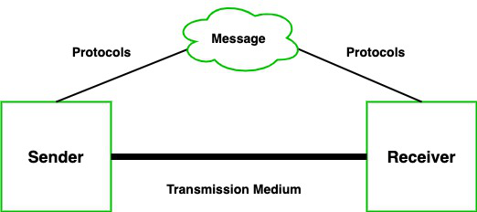
Data Communication

Slide 6
Data Communication
Components of Data Communication
A communication system is made up of the following components:
Message: A message is a piece of information that is to be transmitted from one person to another. It could be a text file, an audio file, a video file, etc.
Sender: It is simply a device that sends data messages. It can be a computer, mobile, telephone, laptop, video camera, or workstation, etc.

Slide 7
Data Communication
Components of Data Communication
Receiver: It is a device that receives messages. It can be a computer, telephone mobile, workstation, etc.
Transmission Medium / Communication Channels: Communication channels are the medium that connect two or more workstations. Workstations can be connected by either wired media or wireless media.
Set of rules (Protocol): When someone sends the data (The sender), it should be understandable to the receiver also otherwise it is meaningless. For example, Sonali sends a message to Chetan. If Sonali writes in Hindi and Chetan cannot understand Hindi, it is a meaningless conversation.

Slide 8
Data Communication
Network Application:
Resource sharing such as printers and storage devices
Exchange of information by means of e-Mails and FTP
Information sharing by using Web
Video conferences
Parallel computing
Instant messaging

Slide 9
Data Communication
Network Architecture
Network Architecture is defined as the physical and logical design of the software, hardware, protocols, and media of the transmission of data.
The two types of network architectures are used:
Peer-To-Peer network
Client/Server network

Slide 10
Data Communication
Peer-To-Peer network
Peer-To-Peer network is a network in which all the computers are linked together with equal privilege and responsibilities for processing the data.
Peer-To-Peer network is useful for small environments, usually up to 10 computers.
Peer-To-Peer network has no dedicated server.
Special permissions are assigned to each computer for sharing the resources, but this can lead to a problem if the computer with the resource is down.

Slide 11
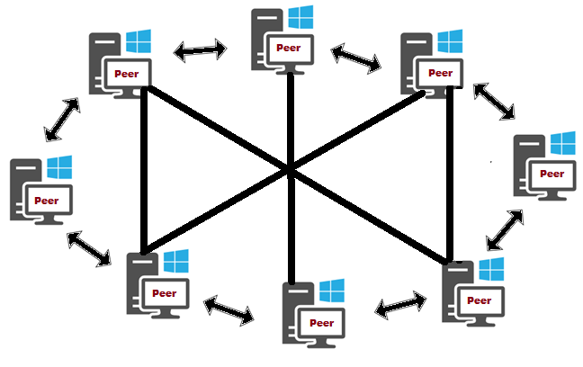
Data Communication
Peer-To-Peer network

Slide 12
Data Communication
Peer-To-Peer network
Advantages Of Peer-To-Peer Network:
It is less costly as it does not contain any dedicated server.
If one computer stops working but, other computers will not stop working.
It is easy to set up and maintain as each computer manages itself.
Disadvantages Of Peer-To-Peer Network:
In the case of Peer-To-Peer network, it does not contain the centralized system . Therefore, it cannot back up the data as the data is different in different locations.
It has a security issue as the device is managed itself.

Slide 13
Data Communication
Client/Server network
Client/Server network is a network model designed for the end users called clients, to access the resources such as songs, video, etc. from a central computer known as Server.
A server is responsible for managing all the resources such as files, directories, printer, etc.
All the clients communicate with each other through a server.

Slide 14
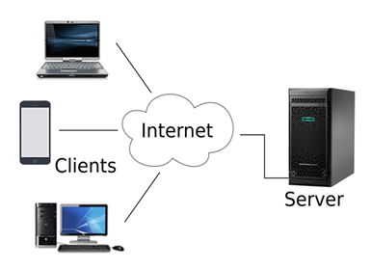
Data Communication
Client/Server network
For example, if client1 wants to send some data to client 2, then it first sends the request to the server for the permission. The server sends the response to the client 1 to initiate its communication with the client 2.

Slide 15
Data Communication
Advantages Of Client/Server network:
A Client/Server network contains the centralized system. Therefore, we can back up the data easily.
A Client/Server network has a dedicated server that improves the overall performance of the whole system.
Security is better in Client/Server network as a single server administers the shared resources.
It also increases the speed of the sharing resources.

Slide 16
Data Communication
Disadvantages Of Client/Server network:
Client/Server network is expensive as it requires the server with large memory.
A server has a Network Operating System(NOS) to provide the resources to the clients, but the cost of NOS is very high.
It requires a dedicated network administrator to manage all the resources.

Slide 17
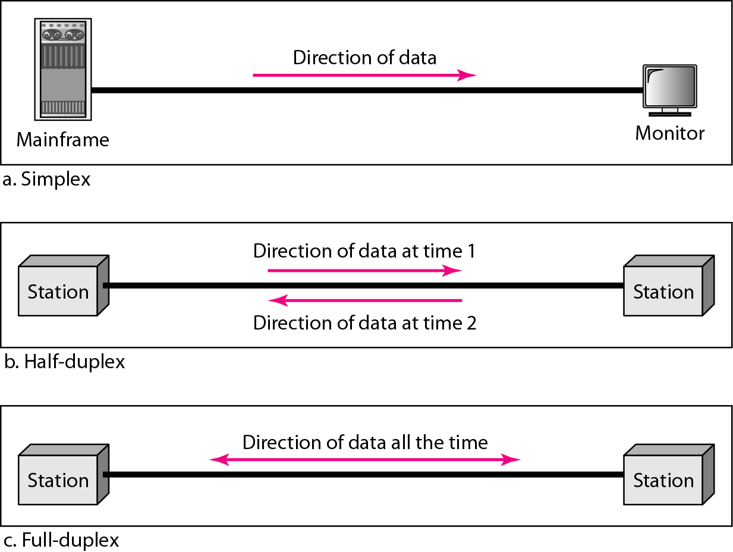
Data Communication
Type of data communication
The data communication is divided into three types:
Simplex Communication
Half Duplex communication
Full-duplex communication

Slide 18
Data Communication
Type of data communication
The data communication is divided into three types:
Simplex Communication
Half Duplex communication
Full-duplex communication

Slide 19
Data Communication
Network Criteria
Performance
Depends on Network Elements
Measured in terms of Delay and Throughput
Reliability
Failure rate of network components
Measured in terms of availability/robustness
Security
Data protection against corruption/loss of data due to:
Errors
Malicious users

Slide 20
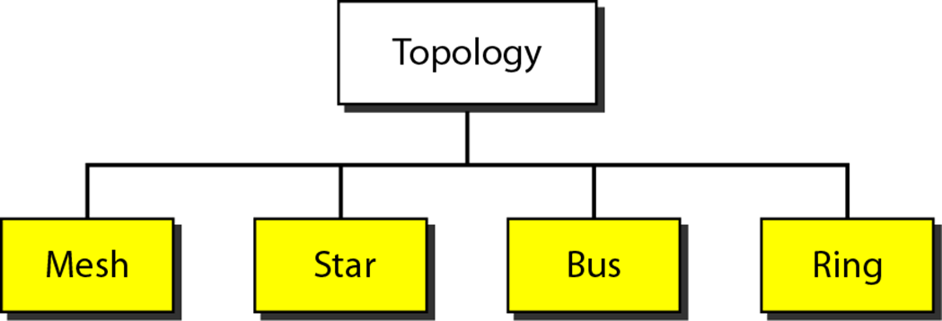
Data Communication
Physical Topology

Slide 21
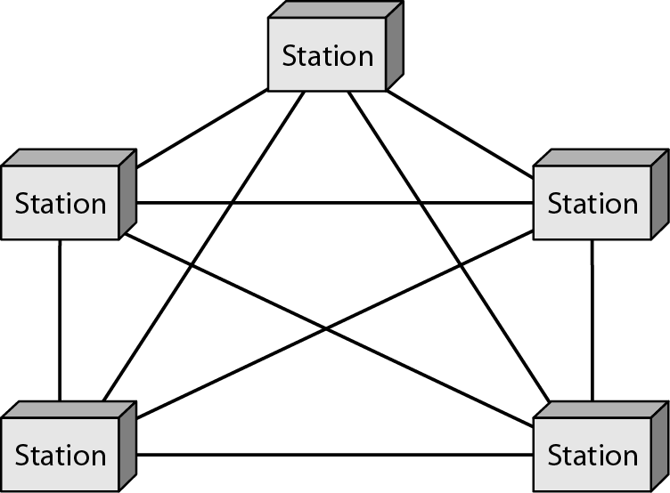
Data Communication
Mesh Topology:
Mesh technology is an arrangement of the network in which computers are interconnected with each other through various redundant connections.
There are multiple paths from one computer to another computer.
It does not contain the switch, hub or any central computer which acts as a central point of communication.

Slide 22
Data Communication
Mesh Topology:
Mesh topology is mainly used for WAN implementations where communication failures are a critical concern.
Mesh topology is mainly used for wireless networks.
Mesh topology can be formed by using the formula: Number of cables = (n*(n-1))/2;

Slide 23
Data Communication
Advantages of Mesh topology:
Reliable: The mesh topology networks are very reliable as if any link breakdown will not affect the communication between connected computers.
Fast Communication: Communication is very fast between the nodes.
Easier Reconfiguration: Adding new devices would not disrupt the communication between other devices.
Disadvantages of Mesh topology
Cost: A mesh topology contains a large number of connected devices such as a router and more transmission media than other topologies.
Management: Mesh topology networks are very large and very difficult to maintain and manage. If the network is not monitored carefully, then the communication link failure goes undetected.
Efficiency: In this topology, redundant connections are high that reduces the efficiency of the network.

Slide 24
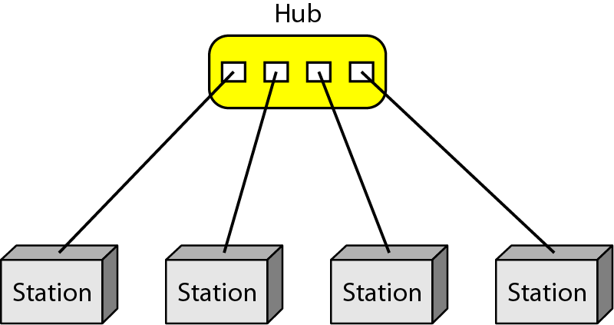
Data Communication
Star Topology
Star topology is an arrangement of the network in which every node is connected to the central hub, switch, or a central computer.
The central computer is known as a server, and the peripheral devices attached to the server are known as clients.
Network cables are used to connect the computers.
Hubs or Switches are mainly used as connection devices in a physical star topology.
Star topology is the most popular topology in network implementation.

Slide 25
Data Communication
Advantages of Star topology
Efficient troubleshooting: Troubleshooting is quite efficient in a star topology as compared to bus topology. In a bus topology, the manager has to inspect the kilometers of cable. In a star topology, all the stations are connected to the centralized network. Therefore, the network administrator has to go to the single station to troubleshoot the problem.
Network control: Complex network control features can be easily implemented in the star topology. Any changes made in the star topology are automatically accommodated.
Limited failure: As each station is connected to the central hub with its own cable, therefore failure in one cable will not affect the entire network.

Slide 26
Data Communication
Advantages of Star topology
Familiar technology: Star topology is a familiar technology as its tools are cost-effective.
Easily expandable: It is easily expandable as new stations can be added to the open ports on the hub.
Cost effective: Star topology networks are cost-effective as it uses inexpensive coaxial cable.
High data speeds: It supports a bandwidth of approx 100Mbps. Ethernet 100BaseT is one of the most popular Star topology networks.

Slide 27
Data Communication
Bus Topology:
The bus topology is designed in such a way that all the stations are connected through a single cable known as a backbone cable.
Each node is either connected to the backbone cable by drop cable or directly connected to the backbone cable.
When a node wants to send a message over the network, it puts a message over the network. All the stations available in the network will receive the message whether it has been addressed or not.
The bus topology is mainly used in 802.3 (ethernet) and 802.4 standard networks.
The configuration of a bus topology is quite simpler as compared to other topologies.
The backbone cable is considered as a "single lane" through which the message is broadcast to all the stations.

Slide 28
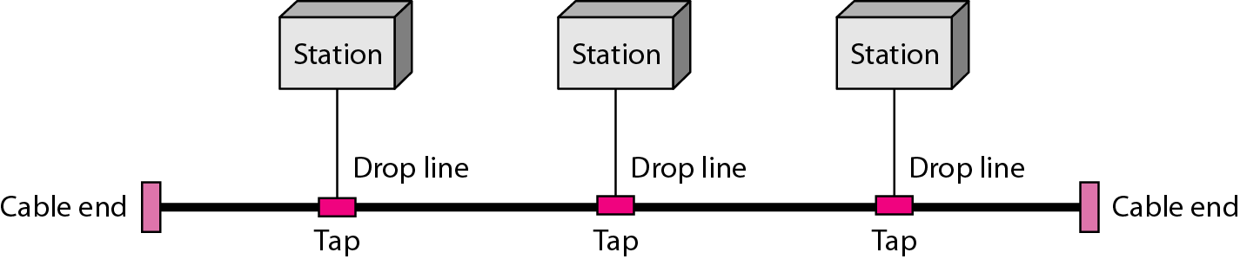
Data Communication
Bus Topology
Advantages of Bus topology:
Low-cost cable: In bus topology, nodes are directly connected to the cable without passing through a hub. Therefore, the initial cost of installation is low.
Moderate data speeds: Coaxial or twisted pair cables are mainly used in bus-based networks that support upto 10 Mbps.
Familiar technology: Bus topology is a familiar technology as the installation and troubleshooting techniques are well known, and hardware components are easily available.
Limited failure: A failure in one node will not have any effect on other nodes.

Slide 29
Data Communication
Disadvantages of Bus topology:
Extensive cabling: A bus topology is quite simpler, but still it requires a lot of cabling.
Difficult troubleshooting: It requires specialized test equipment to determine the cable faults. If any fault occurs in the cable, then it would disrupt the communication for all the nodes.
Signal interference: If two nodes send the messages simultaneously, then the signals of both the nodes collide with each other.
Reconfiguration difficult: Adding new devices to the network would slow down the network.
Attenuation: Attenuation is a loss of signal leads to communication issues. Repeaters are used to regenerate the signal.

Slide 30
Data Communication
Ring Topology:
Ring topology is like a bus topology, but with connected ends.
The node that receives the message from the previous computer will retransmit to the next node.
The data flows in one direction, i.e., it is unidirectional.
The data flows in a single loop continuously known as an endless loop.
It has no terminated ends, i.e., each node is connected to other node and having no termination point.

Slide 31
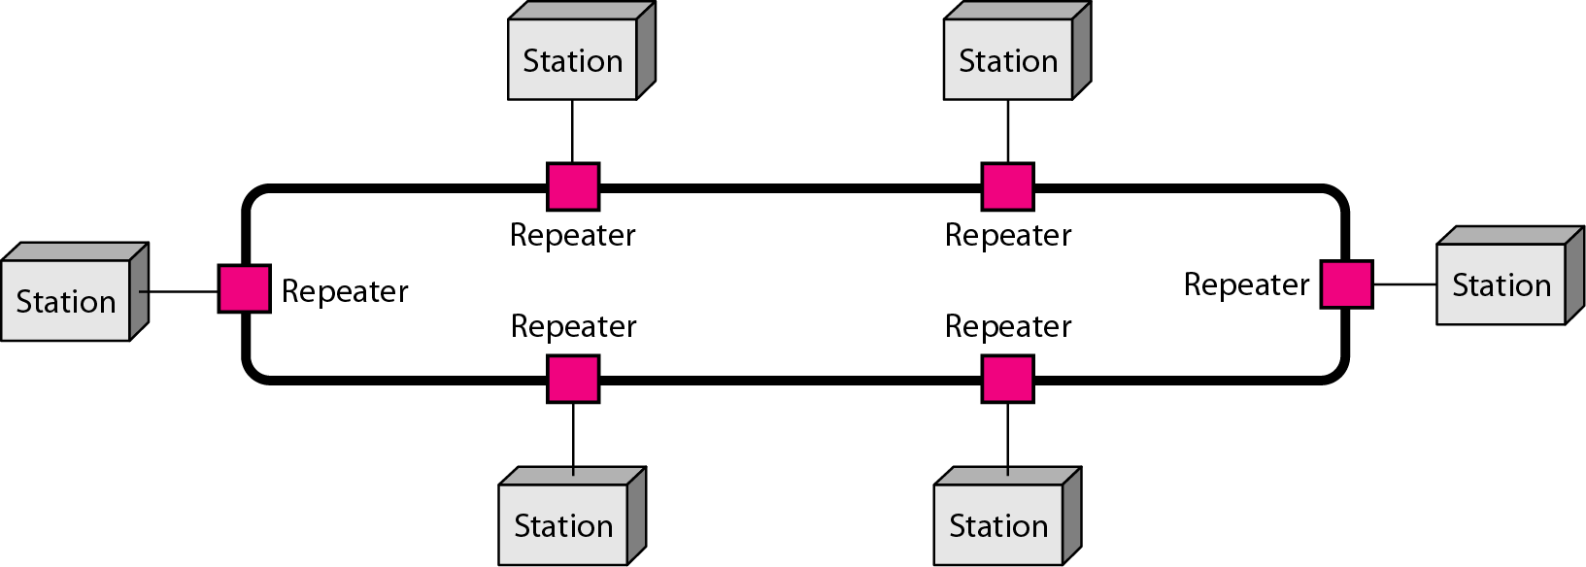
Data Communication
Ring Topology

Slide 32
Data Communication
Ring Topology:
The data in a ring topology flow in a clockwise direction.
Advantages of Ring topology:
Network Management: Faulty devices can be removed from the network without bringing the network down.
Product availability: Many hardware and software tools for network operation and monitoring are available.
Cost: Twisted pair cabling is inexpensive and easily available. Therefore, the installation cost is very low.
Reliable: It is a more reliable network because the communication system is not dependent on the single host computer.

Slide 33
Data Communication
Disadvantages of Ring topology:
Difficult troubleshooting: It requires specialized test equipment to determine the cable faults. If any fault occurs in the cable, then it would disrupt the communication for all the nodes.
Failure: The breakdown in one station leads to the failure of the overall network.
Reconfiguration difficult: Adding new devices to the network would slow down the network.
Delay: Communication delay is directly proportional to the number of nodes. Adding new devices increases the communication delay.

Slide 34
Data Communication
Categories of Networks
Local Area Networks (LANs)
Short distances
Designed to provide local interconnectivity
Metropolitan Area Networks (MANs)
Provide connectivity over areas such as a city, a campus
Wide Area Networks (WANs)
Long distances
Provide connectivity over large areas

Slide 35
Data Communication
Categories of Networks
LAN(Local Area Network)
Local Area Network is a group of computers connected to each other in a small area such as a building, or office.
LAN is used for connecting two or more personal computers through a communication medium such as a twisted pair, coaxial cable, etc.
It is less costly as it is built with inexpensive hardware such as hubs, network adapters, and ethernet cables.
The data is transferred at an extremely faster rate in the Local Area Network.
Local Area Network provides higher security.

Slide 36
Data Communication
Categories of Networks
MAN(Metropolitan Area Network)
A metropolitan area network is a network that covers a larger geographic area by interconnecting a different LAN to form a larger network.
Government agencies use MAN to connect to the citizens and private industries.
In MAN, various LANs are connected to each other through a telephone exchange line.
The most widely used protocols in MAN are RS-232, Frame Relay, ATM, ISDN, OC-3, ADSL, etc.
It has a higher range than the Local Area Network(LAN).

Slide 37
Data Communication
Categories of Networks
WAN(Wide Area Network)
A Wide Area Network is a network that extends over a large geographical area such as states or countries.
A Wide Area Network is quite a bigger network than the LAN.
A Wide Area Network is not limited to a single location, but it spans over a large geographical area through a telephone line, fiber optic cable, or satellite links.
The internet is one of the biggest WANs in the world.
A Wide Area Network is widely used in the field of Business, government, and education.

Slide 38
Data Communication
Internetwork
An internetwork is defined as two or more computer network LANs or WAN or computer network segments are connected using devices, and they are configured by a local addressing scheme. This process is known as internetworking.
An interconnection between public, private, commercial, industrial, or government computer networks can also be defined as internetworking.
The reference model used for internetworking is Open System Interconnection(OSI).

Slide 39
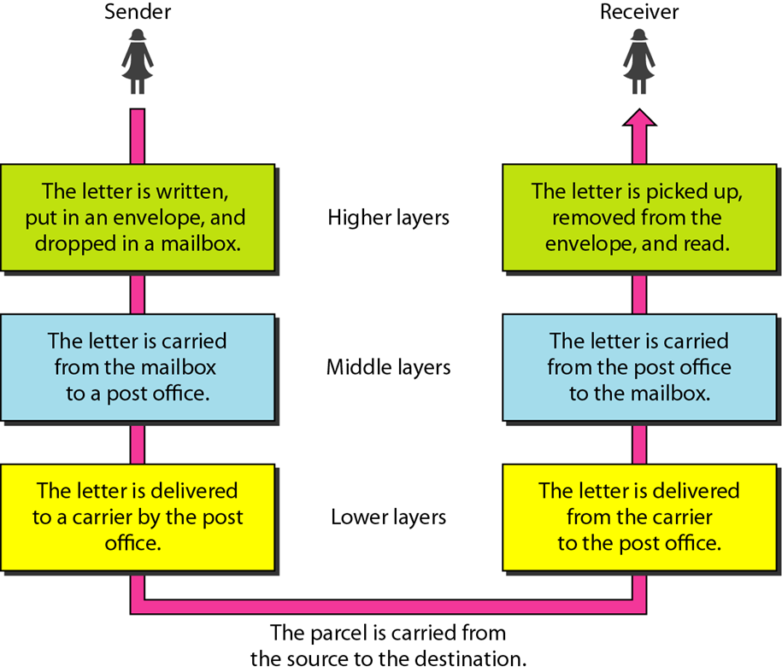
Data Communication
Layered Architecture
We use the concept of layers in our daily life.
As an example, let us consider two friends who communicate through postal mail.
The process of sending a letter to a friend would be complex if there were no services available from the post office

Slide 40
Data Communication
Layered Architecture (THE OSI MODEL)
The main aim of layered architecture is to divide the design into small pieces.
Each lower layer adds its services to the higher layer to provide a full set of services to manage are implemented. Therefore, any modification in a layer will not affect the other layers.
It provides modularity and clear interfaces, i.e., provides interaction between subsystems.

Slide 41
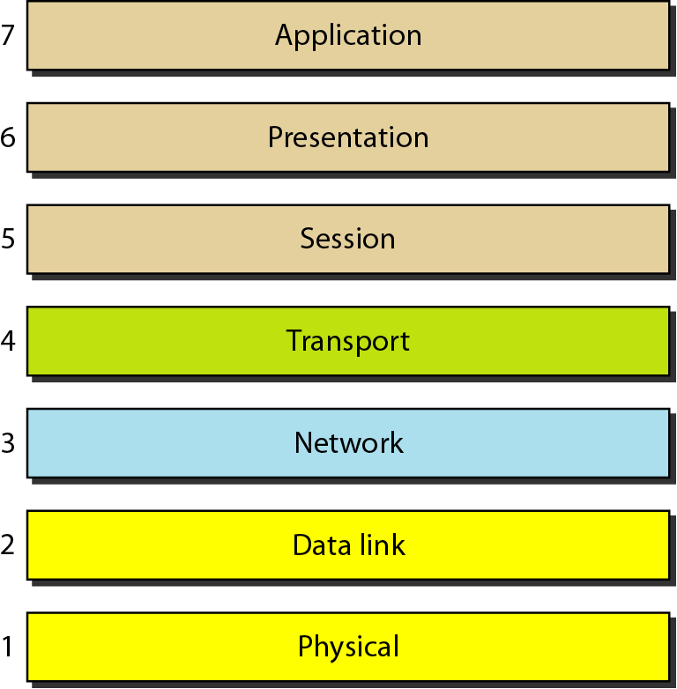
Data Communication
THE OSI MODEL
Established in 1947, the International Standards Organization (ISO) is a multinational body dedicated to a worldwide agreement on international standards.
An ISO standard that covers all aspects of network communications is the Open Systems Interconnection (OSI) model.
It was first introduced in the late 1970s

Slide 42
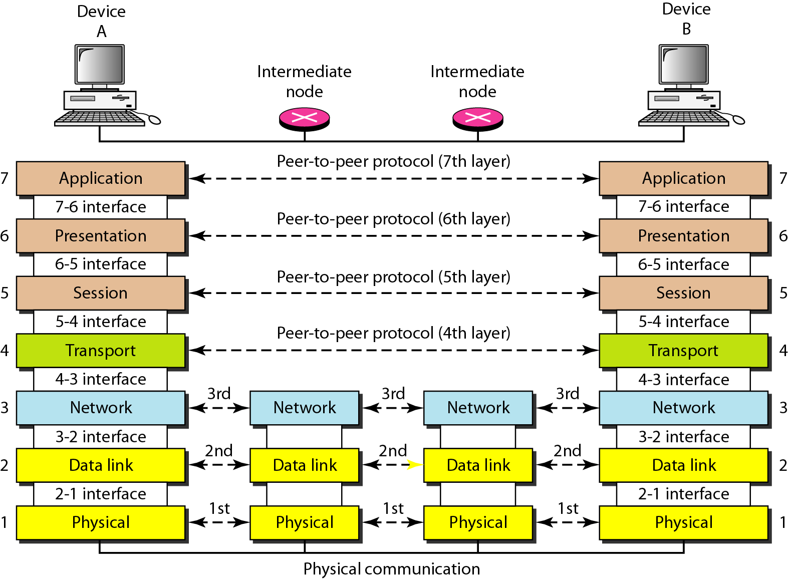
Data Communication
THE OSI MODEL
The interaction between layers in the OSI model

Slide 43
Data Communication
THE OSI MODEL
The interaction between layers in the OSI model

Slide 44
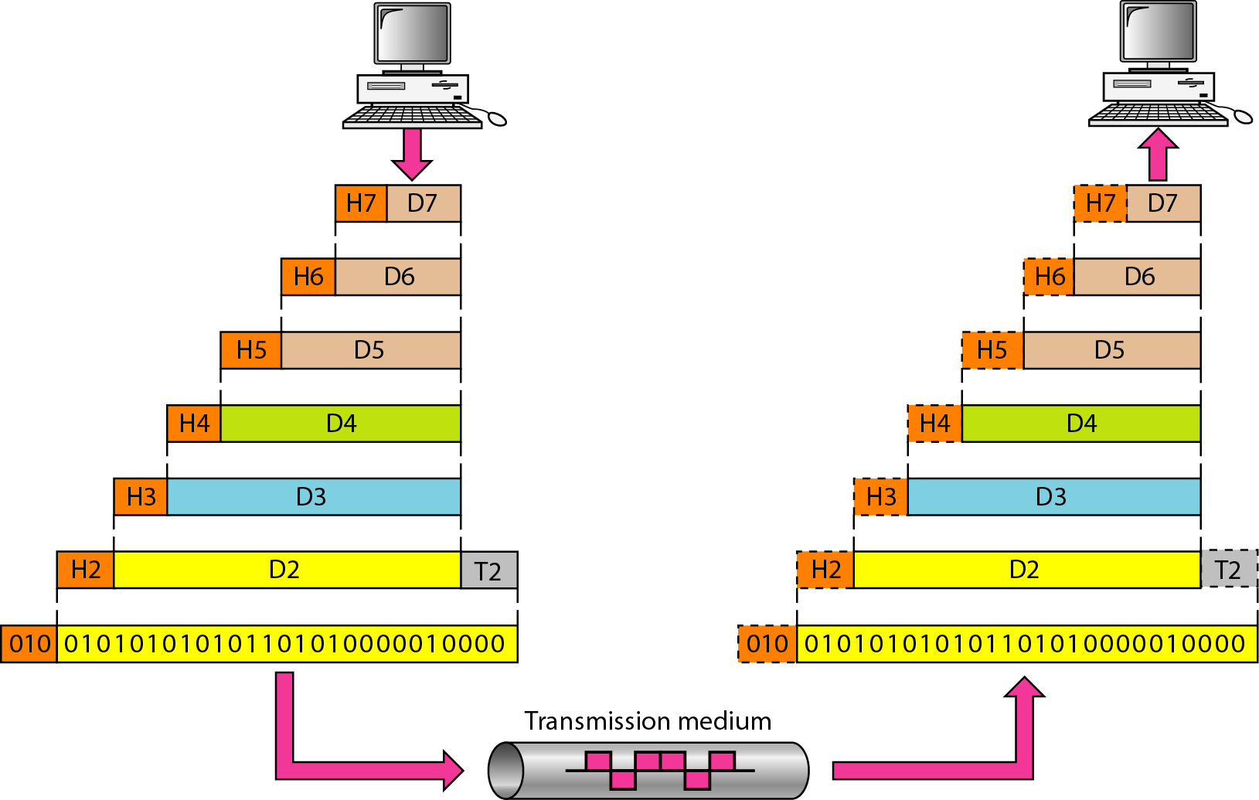
Data Communication
THE OSI MODEL
An exchange using the OSI model

Slide 45
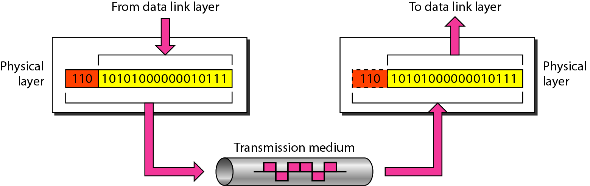
Data Communication
Physical layer:

Slide 46
Data Communication
Physical layer:
The main functionality of the physical layer is to transmit the individual bits from one node to another node.
It is the lowest layer of the OSI model.
It establishes, maintains and deactivates the physical connection.
Functions of a Physical layer:
Line Configuration: It defines the way how two or more devices can be connected physically.
Data Transmission: It defines the transmission mode whether it is a simplex, half-duplex or full-duplex mode between the two devices on the network.
Topology: It defines the way how network devices are arranged.
Signals: It determines the type of signal used for transmitting the information.

Slide 47
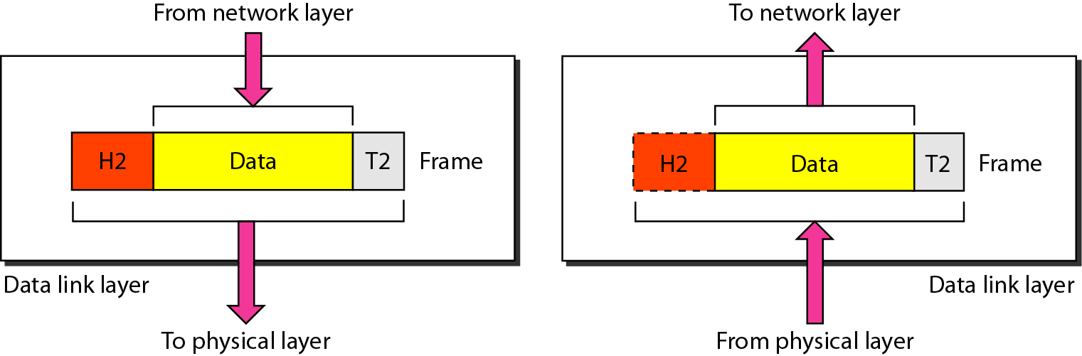
Data Communication
Data-Link Layer:

Slide 48
Data Communication
Data-Link Layer:
This layer is responsible for the error-free transfer of data frames.
It defines the format of the data on the network.
It provides reliable and efficient communication between two or more devices.
It is mainly responsible for the unique identification of each device that resides on a local network.

Slide 49
Data Communication
Data-Link Layer:
It contains two sub-layers:
Logical Link Control Layer
It is responsible for transferring the packets to the Network layer.
It also provides flow control.
Media Access Control Layer
A Media access control layer is a link between the Logical Link Control layer and the network's physical layer.
It is used for transferring the packets over the network.

Slide 50

Data Communication
Data-Link Layer:
Functions of the Data-link layer
Framing: The data link layer translates the physical's raw bit stream into packets known as Frames.
The Data link layer adds the header and trailer to the frame. The header which is added to the frame contains the hardware destination and source address.
Physical Addressing: The Data link layer adds a header to the frame that contains a destination address. The frame is transmitted to the destination address mentioned in the header.

Slide 51
Data Communication
Functions of the Data-link layer
Flow Control: It is the technique through which the constant data rate is maintained on both sides so that no data get corrupted..
Error Control: Error control is achieved by adding a calculated value CRC (Cyclic Redundancy Check) that is placed to the Data link layer's trailer which is added to the message frame before it is sent to the physical layer.
Access Control: When two or more devices are connected to the same communication channel, then the data link layer protocols are used to determine which device has control over the link at a given time.

Slide 52
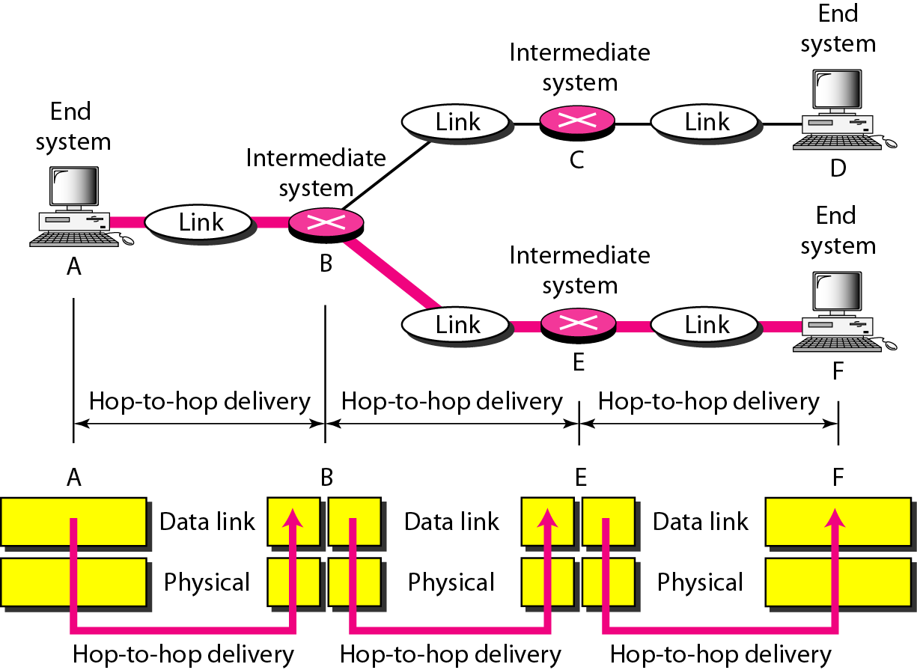
Data Communication
Functions of the Data-link layer

Slide 53
Data Communication
Network Layer;
It is a layer 3 that manages device addressing, and tracks the location of devices on the network.
It determines the best path to move data from source to the destination based on the network conditions, the priority of service, and other factors.
Routers are the layer 3 devices, they are specified in this layer and used to provide the routing services within an internetwork.
The protocols used to route the network traffic are known as Network layer protocols. Examples of protocols are IP and Ipv6.

Slide 54
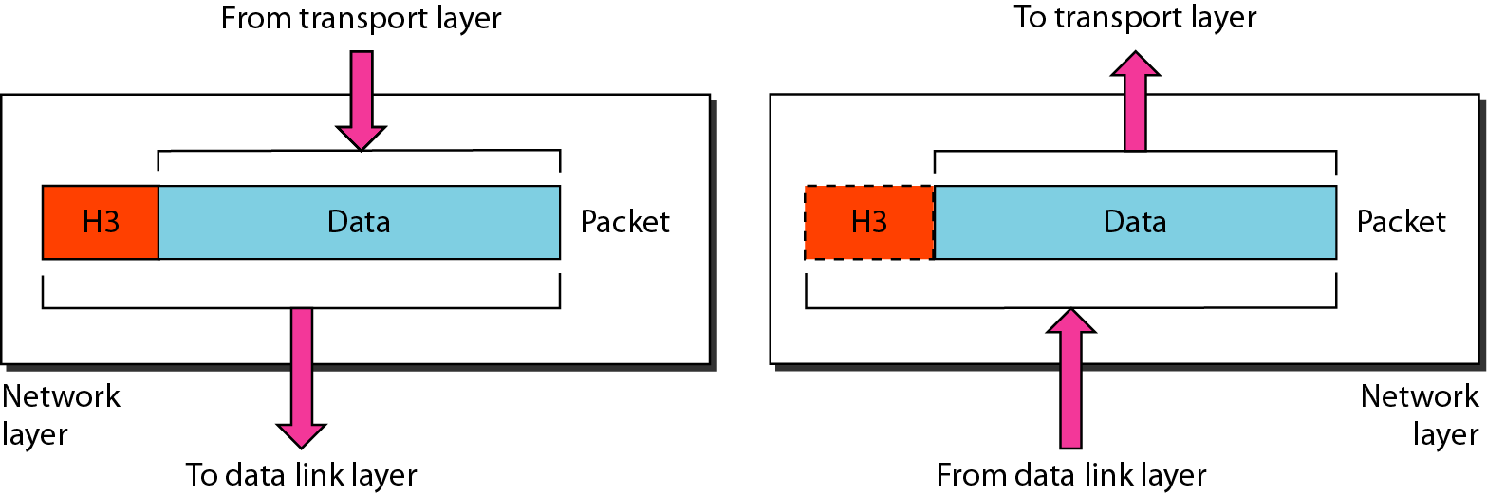
Data Communication
Network Layer

Slide 55
Data Communication
Functions of Network Layer:
Internetworking: Internetworking is the main responsibility of the network layer. It provides a logical connection between different devices.
Addressing: A Network layer adds the source and destination address to the header of the frame. Addressing is used to identify the device on the internet.
Routing: Routing is the major component of the network layer, and it determines the best optimal path out of the multiple paths from source to the destination.
Packetizing: A Network Layer receives the data from the upper layer and converts them into packets. This process is known as Packetizing. It is achieved by internet protocol (IP).

Slide 56
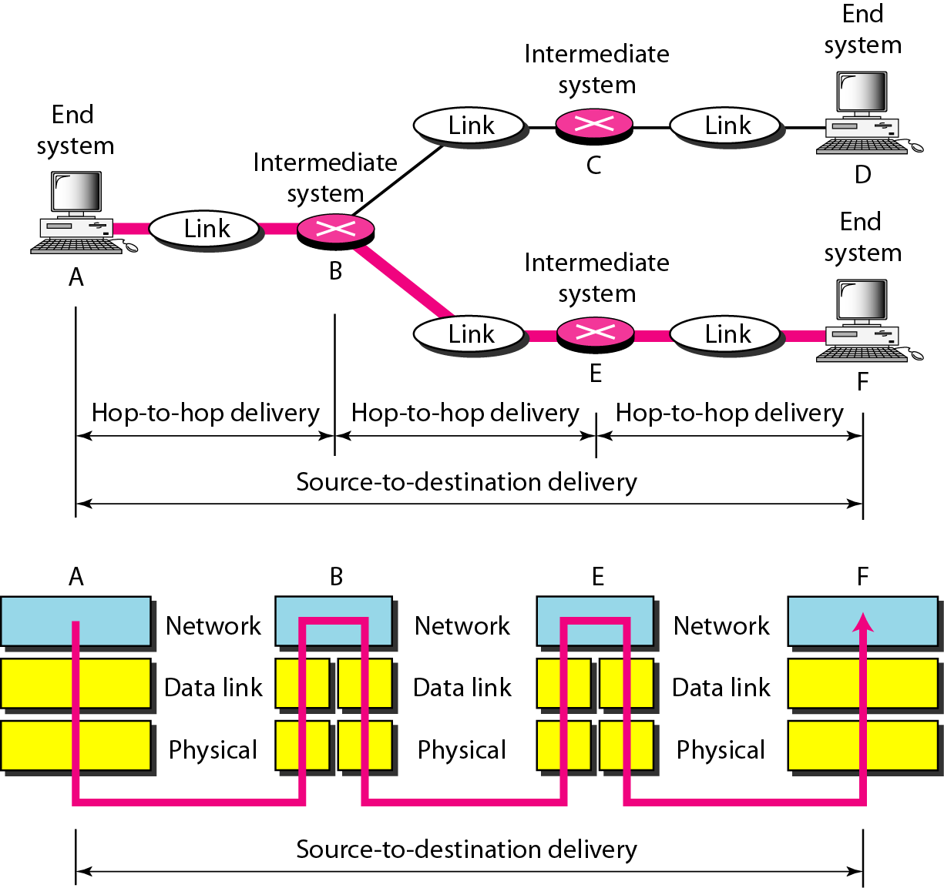
Data Communication
Functions of Network Layer:

Slide 57
Data Communication
Transport Layer:
The Transport layer is a Layer 4 ensures that messages are transmitted in the order in which they are sent and there is no duplication of data.
The main responsibility of the transport layer is to transfer the data completely.
It receives the data from the upper layer and converts them into smaller units known as segments.
This layer can be termed as an end-to-end layer as it provides a point-to-point connection between source and destination to deliver the data reliably.

Slide 58
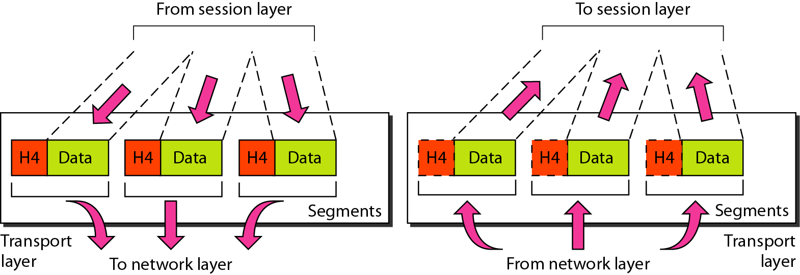
Data Communication
Transport Layer:

Slide 59
Data Communication
Functions of Transport Layer:
Service-point addressing: The transport layer adds the header that contains the address known as a service-point address or port address.
The responsibility of the network layer is to transmit the data from one computer to another computer and the responsibility of the transport layer is to transmit the message to the correct process.
Segmentation and reassembly: When the transport layer receives the message from the upper layer, it divides the message into multiple segments, and each segment is assigned a sequence number that uniquely identifies each segment.
When the message has arrived at the destination, then the transport layer reassembles the message based on its sequence numbers.

Slide 60
Data Communication
Functions of Transport Layer:
Connection control: The transport layer provides two services Connection-oriented service and connectionless service.
A connectionless service treats each segment as an individual packet, and they all travel on different routes to reach the destination.
A connection-oriented service makes a connection with the transport layer at the destination machine before delivering the packets. In connection-oriented service, all the packets travel in a single route.
Flow control: The transport layer is also responsible for flow control but it is performed end-to-end rather than across a single link.
Error control: The transport layer is also responsible for Error control. Error control is performed end-to-end rather than across a single link. The sender transport layer ensures that the message reach at the destination without any error.

Slide 61
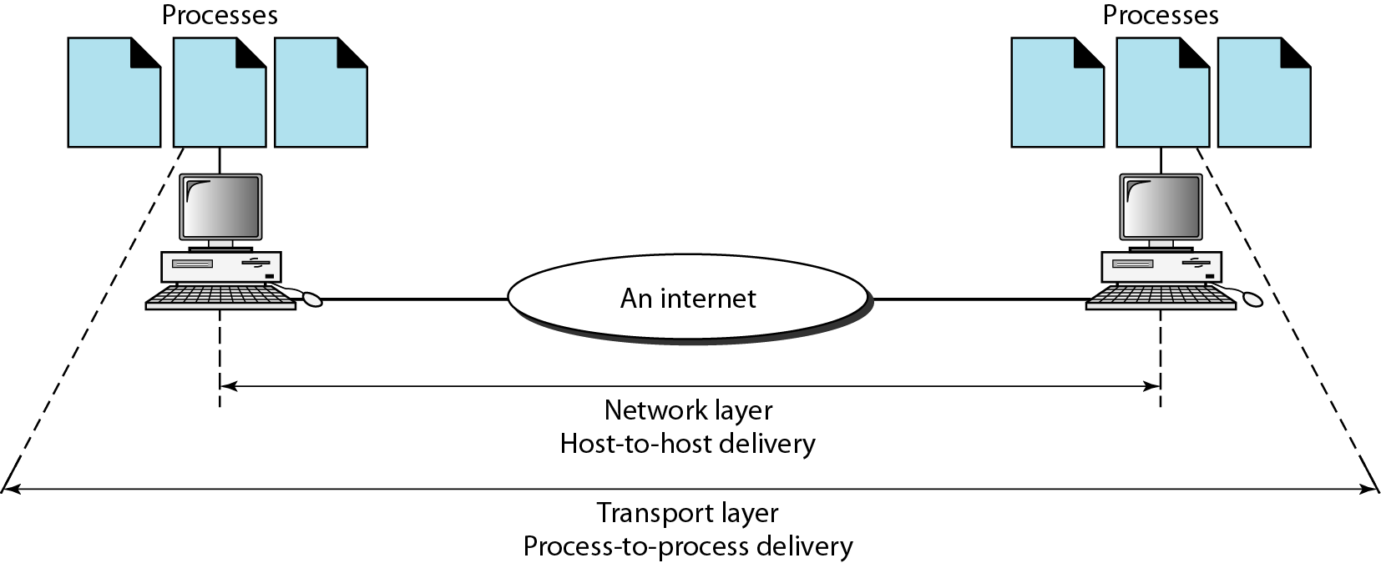
Data Communication
Functions of Transport Layer:

Slide 62
Data Communication
Session Layer:
The Session layer is used to establish, maintain and synchronize the interaction between communicating devices.
Functions of Session layer:
Dialog control: The session layer acts as a dialog controller that creates a dialog between two processes, or we can say that it allows the communication between two processes which can be either half-duplex or full-duplex.
Synchronization: The session layer adds some checkpoints when transmitting the data in a sequence. If some error occurs in the middle of the transmission of data, then the transmission will take place again from the checkpoint. This process is known as Synchronization and recovery.

Slide 63
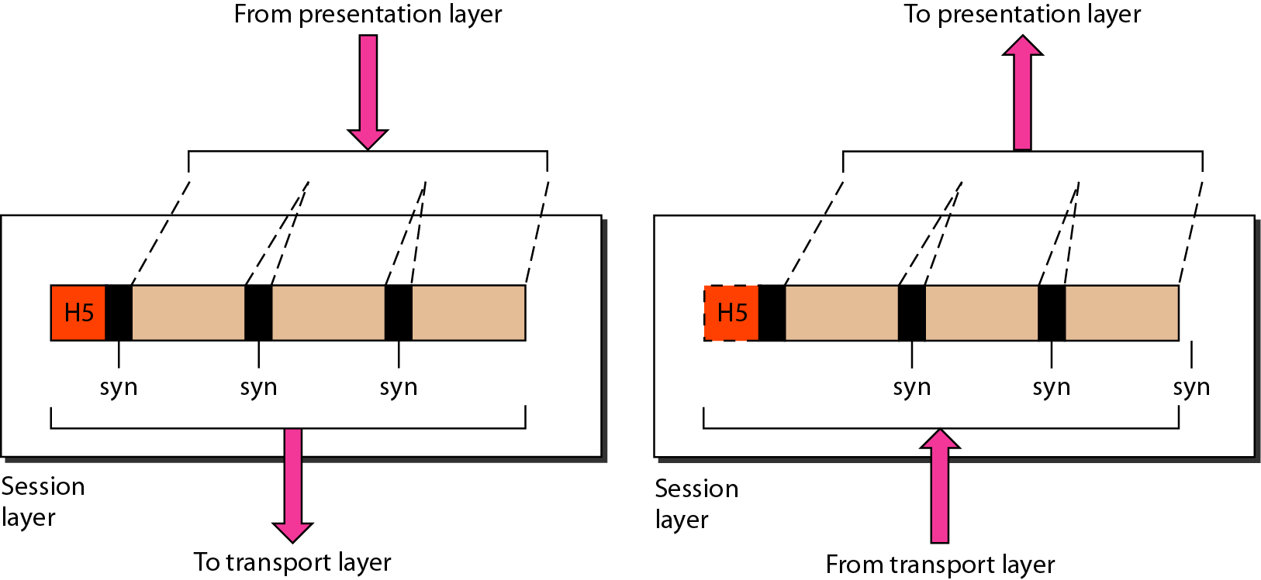
Data Communication
Session Layer:

Slide 64
Data Communication
Presentation Layer:
A Presentation layer is mainly concerned with the syntax and semantics of the information exchanged between the two systems.
It acts as a data translator for a network.
This layer is a part of the operating system that converts the data from one presentation format to another format.
The Presentation layer is also known as the syntax layer.

Slide 65
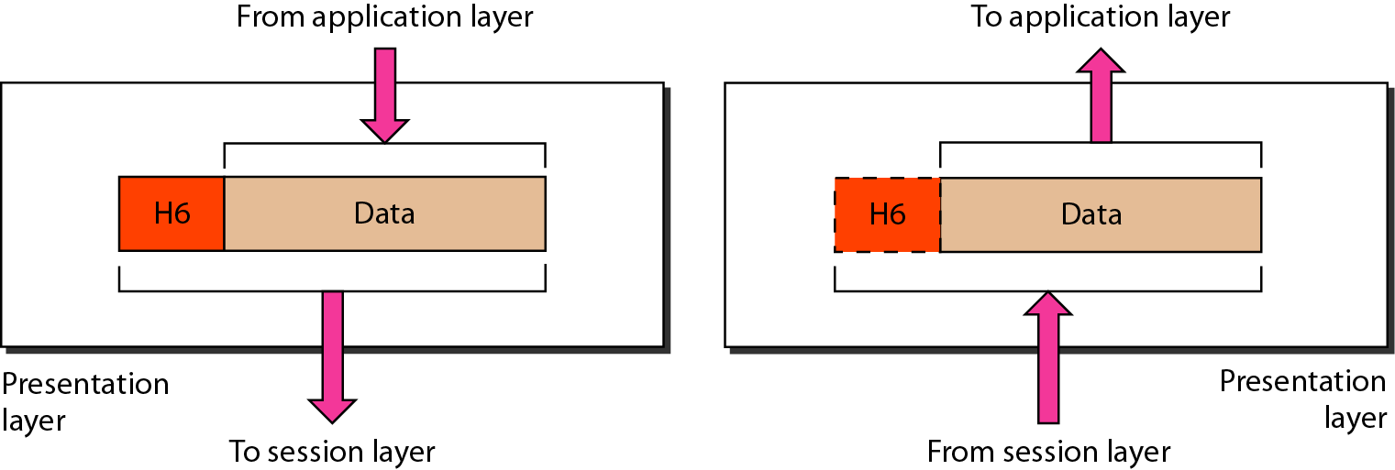
Data Communication
Presentation Layer:

Slide 66
Data Communication
Functions of Presentation layer:
Translation: The processes in two systems exchange the information in the form of character strings, numbers, and so on. Different computers use different encoding methods, the presentation layer handles the interoperability between the different encoding methods. It converts the data from the sender-dependent format into a common format and changes the common format into a receiver-dependent format at the receiving end.
Encryption: Encryption is needed to maintain privacy. Encryption is a process of converting the sender-transmitted information into another form and sends the resulting message over the network.
Compression: Data compression is a process of compressing the data, i.e., it reduces the number of bits to be transmitted. Data compression is very important in multimedia such as text, audio, video.

Slide 67
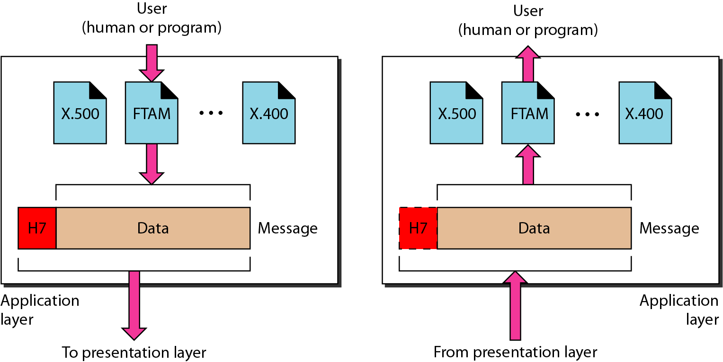
Data Communication
Application layer:
An application layer serves as a window for users and application processes to access network service.
It handles issues such as network transparency, resource allocation, etc.
This layer provides network services to the end-users.

Slide 68
Data Communication
Functions of Application layer:
File transfer, access, and management (FTAM): An application layer allows a user to access the files in a remote computer, retrieve the files from a computer, and manage the files in a remote computer.
Mail services: An application layer provides the facility for email forwarding and storage.
Directory services: An application provides distributed database sources and is used to provide global information about various objects.

Slide 69
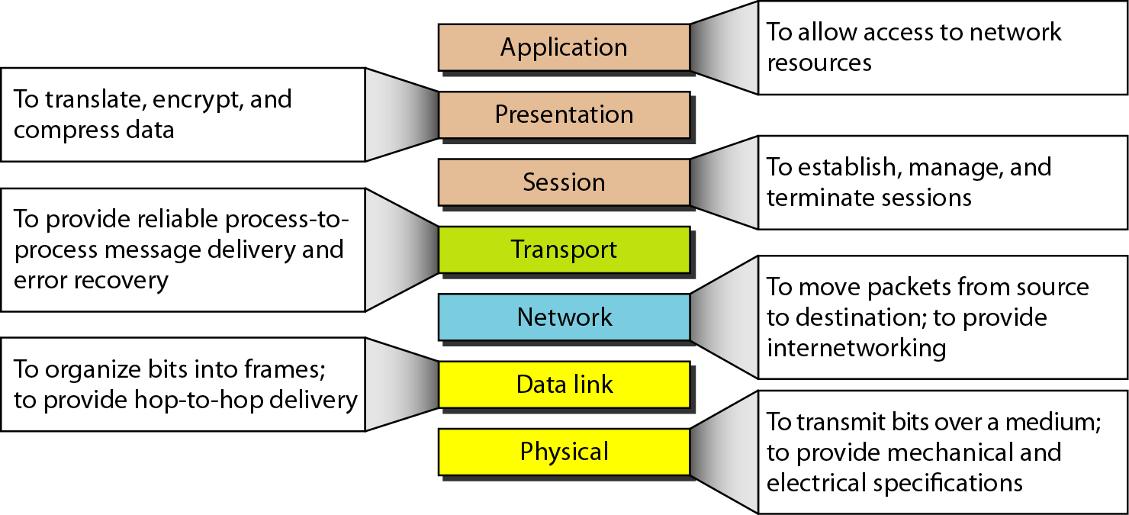
Data Communication

Slide 70
Data Communication
TCP/IP model
The TCP/IP model was developed prior to the OSI model.
The TCP/IP model consists of five layers: the application layer, transport layer, network layer, data link layer and physical layer.
The first four layers provide physical standards, network interface, internetworking, and transport functions that correspond to the first four layers of the OSI model.
Remaining three layers are represented in TCP/IP model by a single layer called the application layer.
TCP/IP is a hierarchical protocol made up of interactive modules, and each of them provides specific functionality.

Slide 71
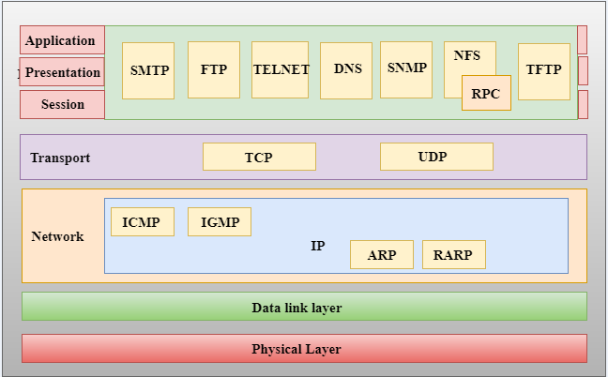
Data Communication
TCP/IP model

Slide 72
References
W. Stallings, Data and Computer Communications, (10e), Pearson Education, 2014.
B. A. Forouzan, Data Communications & Networking, (5e), McGraw Hill, 2013.
D. P. Bertsekas, R. G. Gallager, Data Networks, (2e), Prentice Hall of India, 2011.
A. S. Tenenbaum, Computer Networks, (5e), Prentice Hall of India, 2008.
L. L. Peterson, B. S. Davie, Computer Networks: A Systems Approach, (5e), Morgan Kaufmann Publishers, 2011.

